Slide 1
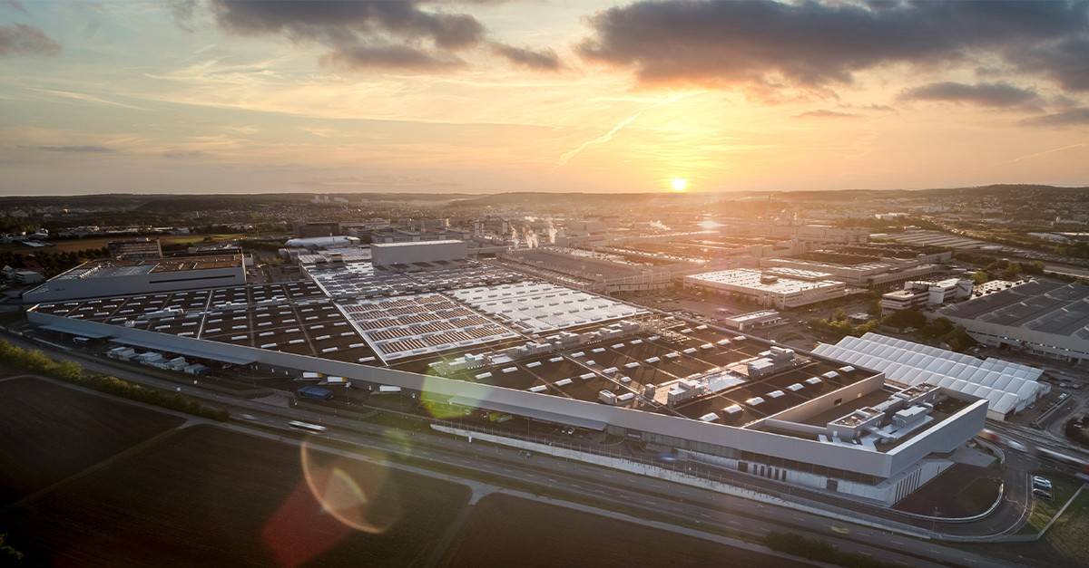
Factory 56 Inspired Smart Manufacturing Facility
PERT Analysis and comparison between PERT and CPM
Ans Mohammed Ayad Elkabir
240270359

Slide 2

What is PERT
PERT stands for Program Evaluation and Review Technique. It is a project management tool used to plan, schedule, and control complex projects where activity times are uncertain.

Slide 3
Objective of PERT
Break a big project into smaller tasks
Estimate how long each task will take (even when unsure)
Find the total project duration
Identify the critical path (tasks that cannot be delayed)
Manage uncertainty in large projects

Slide 4
Key part pf PERT
Instead of one time estimate, PERT uses three estimates:
O = Optimistic time (best case)
M = Most likely time (normal case)
P = Pessimistic time (worst case)
Then it calculates a weighted average:
𝑇𝑒=𝑂+4𝑀+𝑃/ 6 ​

Slide 5
Factory 56 Standard – Sindelfingen Model: PERT Data Table
Planning → Construction → Technical → Digital → Integration → Finalization

Slide 6
Factory 56 Standard – Sindelfingen Model: PERT Date Table
ID | Activity | Phase | Predecessor | O | M | P | Te
A | Feasibility & Site Selection | Planning | - | 30 | 45 | 70 | 46.7
B | Regulatory & Environmental Approvals | Planning | A | 40 | 60 | 90 | 61.7
C | Master Plant Layout & Digital Mockup | Planning | A | 25 | 40 | 60 | 40.8
D | Detailed Civil & Structural Design | Planning | B, C | 50 | 75 | 110 | 76.7
E | Site Preparation & Groundworks | Construction | D | 60 | 90 | 130 | 91.7
F | Foundation & Structural Frame | Construction | E | 70 | 100 | 150 | 103.3
G | Building Envelope (Carbon-Neutral) | Construction | F | 50 | 80 | 120 | 81.7

Slide 7
Factory 56 Standard – Sindelfingen Model
H | Utility Tunnels & Ducts | Construction | F | 40 | 60 | 90 | 61.7
I | HV Electrical & Renewable Integration | Technical | G | 60 | 85 | 120 | 86.7
J | HVAC & Clean Air Systems | Technical | G | 50 | 75 | 110 | 76.7
K | Water & Circular Economy Systems | Technical | H | 40 | 65 | 95 | 65.8
L | Robotic Assembly Line Installation | Technical | I, J | 90 | 130 | 180 | 131.7
M | AGV & Intralogistics Network | Technical | K | 60 | 90 | 130 | 91.7
N | Edge Computing & 5G Infrastructure | Digital | G | 50 | 70 | 100 | 71.7
O | IoT Sensor Network Deployment | Digital | N | 40 | 60 | 85 | 60.8

Slide 8
Factory 56 Standard – Sindelfingen Model
P | Digital Twin Platform Setup | Digital | O | 70 | 100 | 140 | 101.7
Q | AI Quality & Predictive Maintenance | Digital | P | 60 | 90 | 130 | 91.7
R | MES & ERP Integration | Digital | L, M | 50 | 80 | 120 | 81.7
S | System Integration Testing | Integration | R, Q | 60 | 90 | 130 | 91.7
T | Trial Production (Pilot Run) | Integration | S | 40 | 60 | 90 | 61.7
U | Staff Training & Digital Ops Handover | Integration | S | 30 | 50 | 80 | 51.7
V | Final Commissioning | Finalization | T, U | 25 | 40 | 70 | 42.5

Slide 9
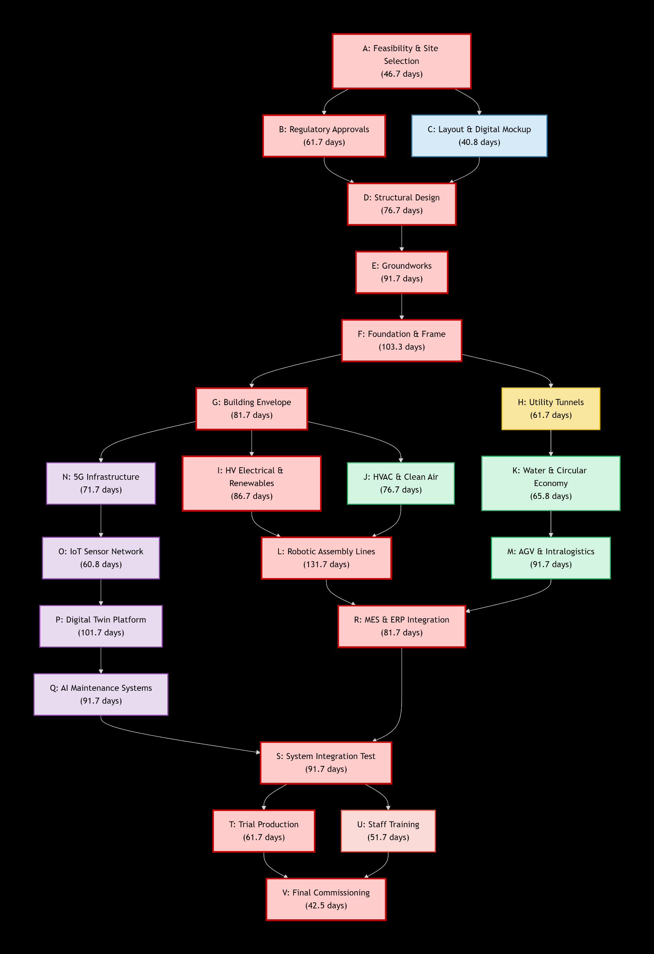

Slide 10
Critical Path (Total Expected Duration)
A → B → D → E → F → G → I → L → R → S → T → V
Total Te =
46.7 + 61.7 + 76.7 + 91.7 + 103.3 + 81.7 + 86.7 + 131.7 + 81.7 + 91.7 + 61.7 + 42.5
= ~785 days (~2.18 years)

Slide 11
What Makes This “Factory 56 Level”
Heavy digital dependency (L → P → R)
Parallelization:
Robotics (L)
Logistics (M)
Energy (N)
Smart factory complexity driven by:
Digital Twin
AI systems
Autonomous logistics (AGVs)

Slide 12
Comparison between PERT and CPM
In CPM we use:
ES (Earliest Start)
EF (Earliest Finish)
LS (Latest Start)
LF (Latest Finish)
Slack (Float)
Final Critical Path (confirmed numerically)

Slide 13
CPM method
EF = ES + Te
LS = LF − Te
Slack = LS − ES
Total time 794.5 days (~2.18 years)
CONFIRMED CRITICAL PATH (ZERO SLACK) A → B → C → G → H → I → J → L → P → R → S → U

Slide 14
CPM method
ID | Te | Pred | ES | EF | LS | LF | Slack
A | 31.7 | - | 0 | 31.7 | 0 | 31.7 | 0
B | 45.0 | A | 31.7 | 76.7 | 31.7 | 76.7 | 0
C | 61.7 | B | 76.7 | 138.4 | 76.7 | 138.4 | 0
D | 40.0 | A | 31.7 | 71.7 | 88.4 | 128.4 | 56.7
E | 90.0 | D | 71.7 | 161.7 | 128.4 | 218.4 | 56.7
F | 31.7 | D | 71.7 | 103.4 | 133.4 | 165.1 | 61.7
G | 46.7 | C | 138.4 | 185.1 | 138.4 | 185.1 | 0
H | 71.7 | G | 185.1 | 256.8 | 185.1 | 256.8 | 0
I | 91.7 | H | 256.8 | 348.5 | 256.8 | 348.5 | 0
J | 76.7 | I | 348.5 | 425.2 | 348.5 | 425.2 | 0
K | 61.7 | H | 256.8 | 318.5 | 283.5 | 345.2 | 26.7
L | 101.7 | J,E | 425.2 | 526.9 | 425.2 | 526.9 | 0
M | 86.7 | J,F | 425.2 | 511.9 | 440.2 | 526.9 | 15.0
N | 76.7 | K | 318.5 | 395.2 | 450.2 | 526.9 | 131.7
O | 71.7 | J | 425.2 | 496.9 | 455.2 | 526.9 | 30.0

Slide 15
CPM method
ON-CRITICAL ACTIVITIES (Flexible)
Examples:
D, E → large slack (~56 days)
N → VERY flexible (131 days!)
Q → moderate slack
M, O, T → small flexibility

Slide 16
CPM method
ON-CRITICAL ACTIVITIES (Flexible)
Examples:
D, E → large slack (~56 days)
N → VERY flexible (131 days!)
Q → moderate slack
M, O, T → small flexibility

Slide 17
CPM method
1. Bottlenecks
Structural completion (I → J)
Robotics installation (L)
Digital twin integration (P)
Final system integration (R)
2. Risk Zones
Digital systems (P, Q)
Robotics (L)
Permitting delays (C)
3. Optimization Strategy
Crash activities:
L (Robotics)
P (Digital Twin)
Use slack from:
N (Energy system)
Q (AI systems)

Slide 18
CONCLUSION
PERT + CPM are essential for mega projects
Critical path determines project success
Industry 4.0 increases complexity but improves efficiency

